Slide 1
Compiler Construction
COMP 7.1
Unit 1

Slide 2

Course Outcomes
Course Outcome No. | CO Description | Cognitive Level
COMP 7.1.1 | Define the components and phases of the compiler, and the types of parsers. | CL1
COMP 7.1.2 | Explain the components and phases of the compiler. | CL2
COMP 7.1.3 | Apply algorithms to design a lexical analyser, construct a parser by hand, generate intermediate code and target code. | CL3
COMP 7.1.4 | Write a LEX/YACC specification for a given Regular Expression/Grammar and use the LEX/YACC tool. | CL3
Compiler Construction

Slide 3
Unit 1 Syllabus
Language Processor Concepts Questions
Data Structures for language processors. Questions
Introduction to Compiler: Questions
1.3 Phases of compilation,
Bootstrapping and Porting,
1.6 Compiler writing tools.
The role of a lexical analyser. Questions
Design of lexical analyser.
Implementation of lexical analyser.
A Language for specifying lexical analyser.
Study of the features and applications of LEX/FLEX tool.

Slide 4

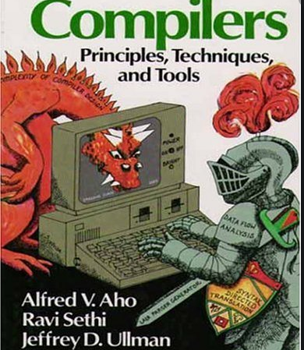
Recommended Readings:
1. Aho and Ulman ; Principles of Compiler Design; Narosa publishing House, ISBN: 81-85015-61-9.
2.Aho, Ulman and Sethi; Compilers, Principles, techniques and tools; Pearson Education Asia, ISBN: 81-7808-046-X.
3. Vinu V. Das; Compiler design with FLEX and YACC; PHI publication, ISBN:978- 81-203-3251-5
4. Louden; Compiler Construction, Principles and Practice; Galgotia Publication, ISBN:0-534-93972-4

Slide 5

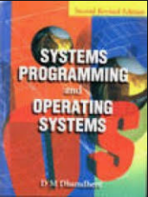
Introduction
Dhamdhere D. M., Systems Programming and Operating Systems, Ed. 2, 1999.

Slide 6
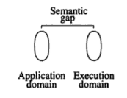
Language Processor Concepts
Application Domain –
Software designer expresses ideas
Execution Domain –
Computer system that implements these ideas
Semantic Gap –
Semantic represents the rules of meaning of a domain
Gap is the difference between the semantics of the two domains
Consequences – large development times/efforts, and poor quality of software

Slide 7

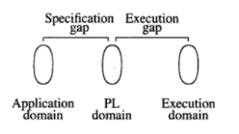
Software engineering bridges the semantic gap
Software implementation using a Programming Language (PL) introduces a new domain, the PL domain
Step 1: specification gap
Step 2: execution gap

Slide 8
A language processor is a software which bridges a specification or execution gap.
Input – source program written in source language
Output – target program written in target language
Function – activity of the language processor
Advantages:
Reduces the severity of the consequences of the semantic gap
Provides a diagnostic capability which detects and indicates errors in its input - > improves the quality of the software

Slide 9
Types of language processors:
Language Translator – bridges an execution gap to the machine language (or assembly language) of a computer system.
Assembler: Language Translator whose source language is assembly language.
Compiler: any language translator which is not an assembler.
Detranslator – bridges the same execution gap as the language translator, but in the reverse direction.
E.g. ildasm.exe – it is a CIL decompiler. It translates an assembly’s binary opcodes into their
corresponding CIL mnemonics.
Preprocessor – a language processor which bridges an execution gap but is not a language translator.
4. Language migrator – bridges the specification gap between two PLs.

Slide 10
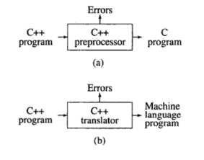
Figure ‘a’ – Pre-processor converts the input source program C++ into another high level language program
Figure ‘b’ – Language translator for C++ since it produces a machine language program

Slide 11
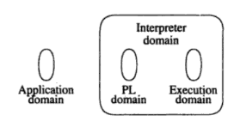
Interpreter is a language processor which bridges an execution gap without generating a machine language program.

Slide 12
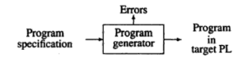
Language Processing Activities:
1) Program generation activities
2) Program execution activities
Program generation

Slide 13
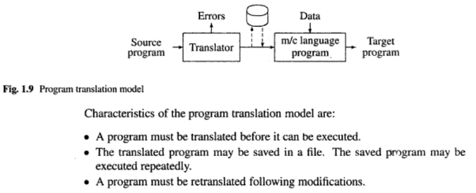
Program execution
2 popular models –
translation

Slide 14
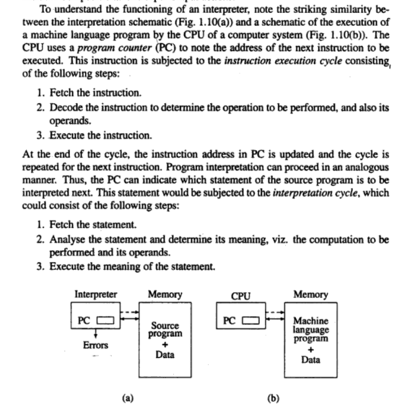
b) Interpretation
Characteristics:
Source program is retained in the source form itself, i.e. no target program exists
A statement is analysed during its interpretation.

Slide 15
Translation
A fixed cost (the translation overhead) is incurred in the use of the program translation model.
If the source program is modified, the translation cost must be incurred again irrespective of the size of the modification.
However, execution of the target program is efficient since the target program is in the machine language.
Interpretation
Does not incur the translation overheads.
Advantageous if a program is modified between executions, as in program testing and debugging.
Slower than execution of a machine language program because of step 2 in the interpretation cycle.

Slide 16
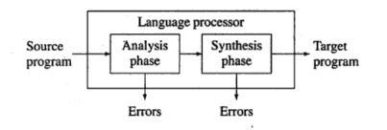
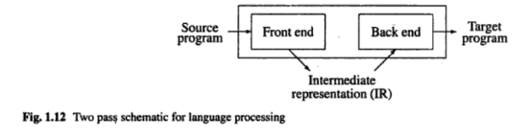
Fundamentals of Language Processing
Phase
Pass – processing for every statement in a source program. 2 pass model, forward reference

Slide 17
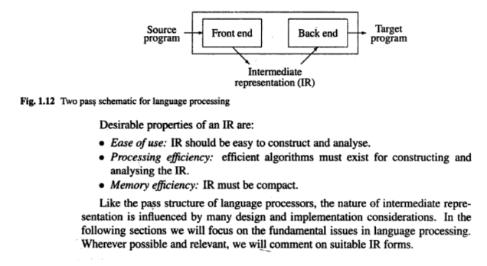
Intermediate representation – representation of a source program which reflects the effect of some, but not all, analysis and synthesis tasks performed during language processing.

Slide 18
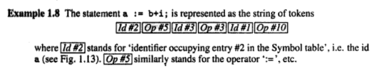
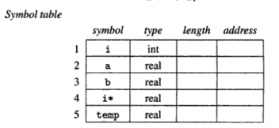
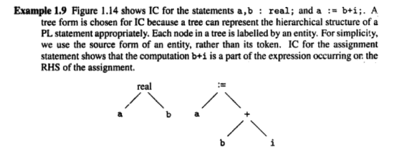
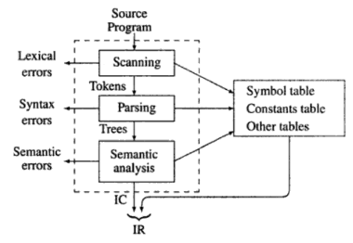
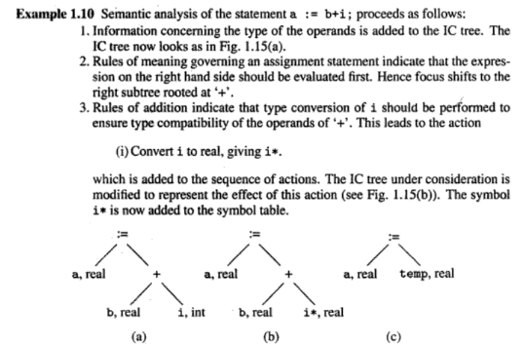
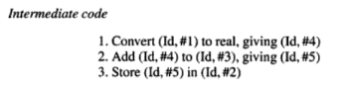
Example, Front End

Slide 19
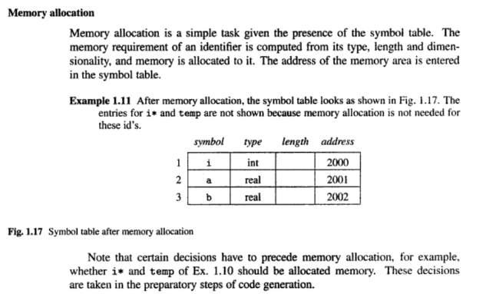
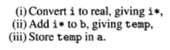
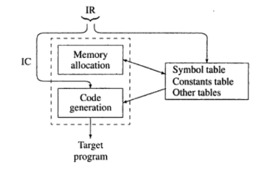
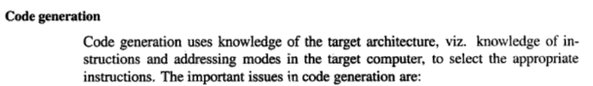
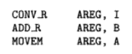
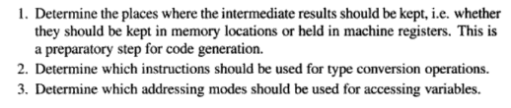
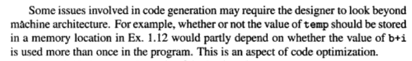
Example, Back-end

Slide 20
Fundamentals of Language Specification
Specification of the source language forms the basis of source program analysis
Lexical and syntactic features of a programming language are specified by its grammar
A language L is a collection of valid sentences
Each sentence is a sequence of words
Each word is a sequence of letters or graphic symbols acceptable in L
A language specified in this manner is known as a formal language

Slide 21
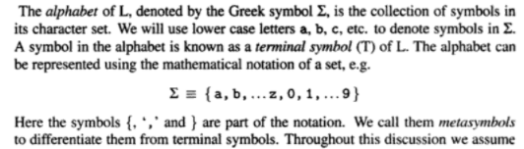
A formal language grammar is a set of rules which precisely specify the sentences of L.

Slide 22
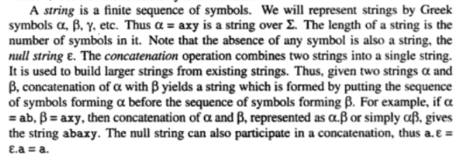

Slide 23
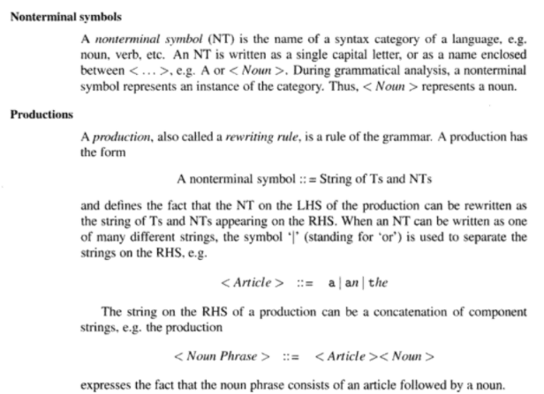

Slide 24
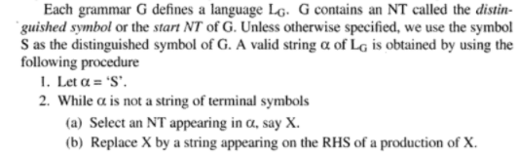

Slide 25
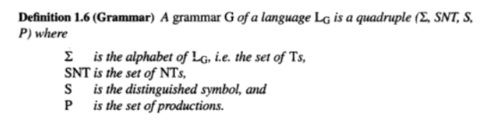

Slide 26
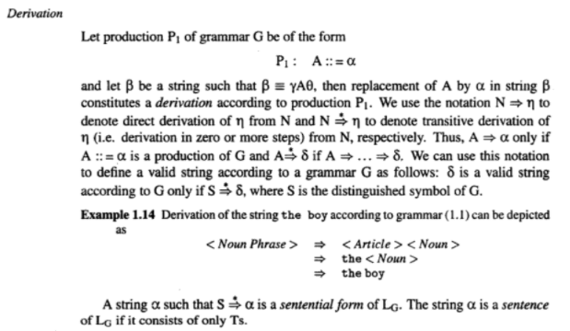

Slide 27
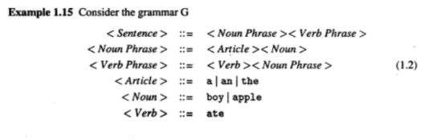
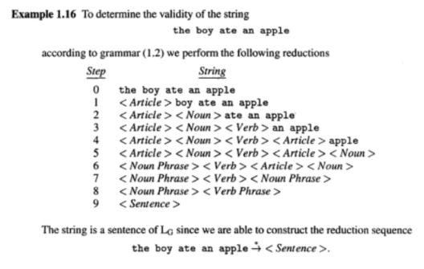

Slide 28
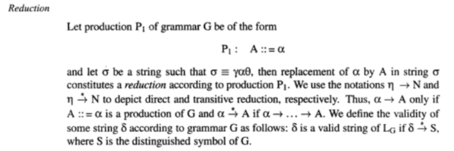

Slide 29
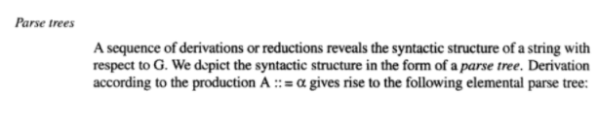
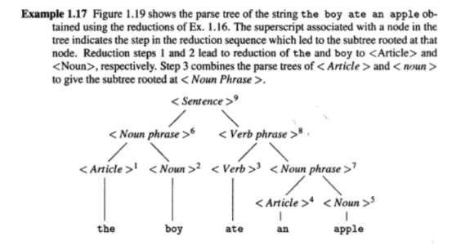

Slide 30
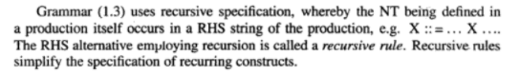

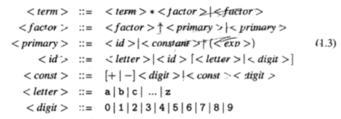
Recursive Specification

Slide 31
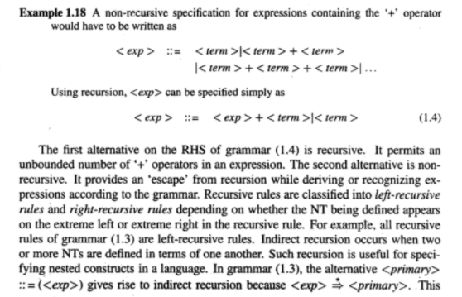

Slide 32
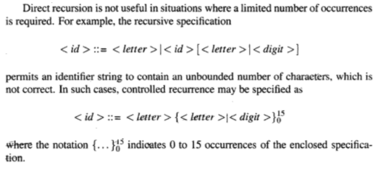

Slide 33
Classification of Grammars
Grammars are classified by the nature of productions used in them.
Each grammar class has its characteristics and limitations.

Slide 34
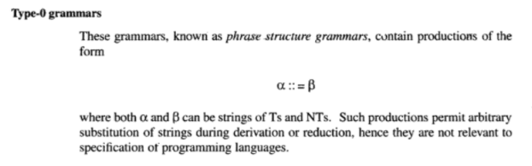

Slide 35
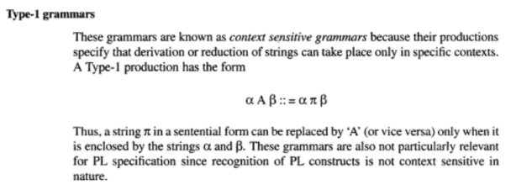

Slide 36
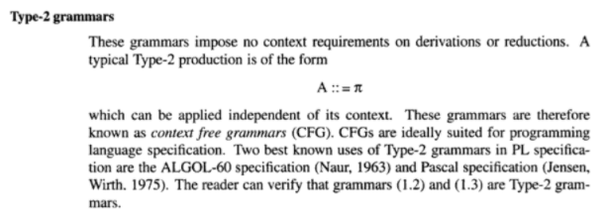

Slide 37
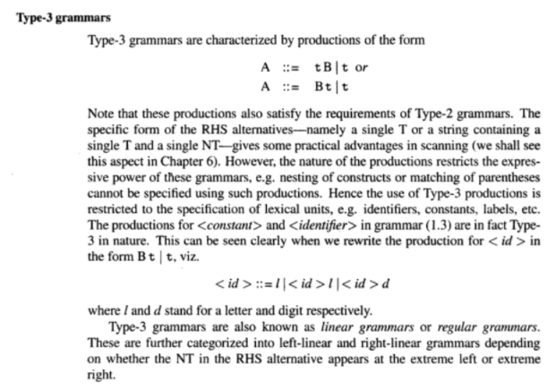

Slide 38
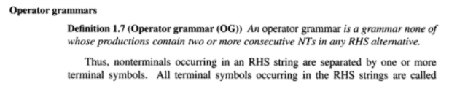
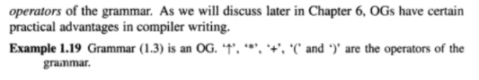
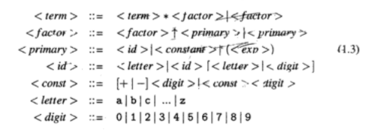

Slide 39
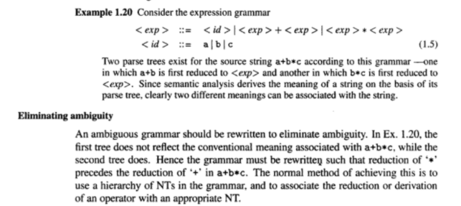

Slide 40
Language Processor Development Tools
Analysis phase of a language processor has a standard form irrespective of its purpose.
The source text is subjected to lexical, syntax and semantic analysis and the results of analysis are represented in an IR.
Thus writing of language processors is a well understood and repetitive process
This has led to the development of a set of language processor development tools (LPDTs) focussing on generation of the analysis phase of language processors

Slide 41
The LPDT requires two inputs:
Specification of a grammar of language L
Specification of semantic actions to be performed in the analysis phase
LPDT generates programs that perform lexical, syntax, and semantic analysis of the source program and construct the IR
Two LPDTs widely used in practice are:
The Lexical analyser generator LEX
The Parser generator YACC

Slide 42
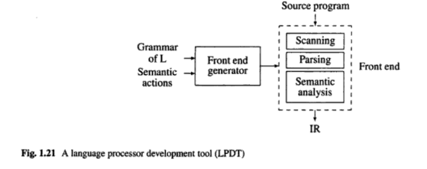

Slide 43
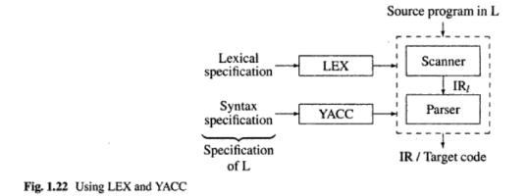

Slide 44


Slide 45


Slide 46



Slide 47


Slide 48


Questions
ND2019
Aug 2020

Slide 49


Oct 2020
Aug 2021

Slide 50


Hints:
Ref: http://marvin.cs.uidaho.edu/Teaching/CS445/c-Grammar.pdf

Slide 51
Sample Answers
Nested switch statement.
<stmt> -> switch(<expr>){<mult case stmt>}
<mult case stmt> -> <case stmt> <mult case stmt> | epsilon
<case stmt> -> case <expr>:<stmt> | case <expr>:<mult case stmt> | default:<stmt>
<stmt>->break;

Slide 52
Function definition with at least two assignments, and for loop statement inside function definition.
funDeclaration -> typeSpecifier ID(params) statement | ID(params) statement
params -> paramList | epsilon
paramList -> paramList; paramTypeList | paramTypeList
paramIdList -> paramIdList, paramId | paramId
paramId -> ID | ID[]
statement -> expressionStmt | forStmt
expressionStmt -> expression; | ;
expression-> mutable=expression | mutable++ | mutable-- | ++mutable |--mutable
mutable-> ID | mutable[expression]
forStmt -> for(expression; relExpression; expression){statement;}
relExpression -> expression relop expression
relop -> <= | < | > | >= | == | !=

Slide 53
More questions:
Are passes and intermediate representation necessary during language processing? Explain. [5]
Where are grammars used in language translation? What are the types of grammars? [6]
Compare program translation and program interpretation. [6]
Explain recursive grammar specifications. How are recursive rules classified? Differentiate between direct recursion and indirect recursion. [4]
Define language processor, forward reference.
What is an interpreter? What are its characteristics? Explain with a neat diagram. [5]
What are the two popular models for program execution? What are their characteristics? [6]
How is a forward reference handled by a language processor? [4]

Slide 54
Questions
The End
of
“Language Processors” Concepts

Slide 55

Data Structures for language processors.
A language processor makes frequent use of the search operation over its data structures.
E.x. The symbol table is a data structure that :
Records the variable names used in the source program
Collects information about various attributes, e.x. type, scope, of each name.

Slide 56
Types of data structures:
Linear Lists
Trees
Hash tables

Slide 57
Data structures used in language processing can be classified based on the following criteria:
Nature of data structure – whether a linear or nonlinear data structure
Purpose of a data structure – whether a search data structure or an allocation data structure
Lifetime of a data structure – whether used during language processing or during target program execution.

Slide 58

Linear – array
Nonlinear – linked list

Slide 59

Search data structure:
Maintains attribute information concerning different entities in the source program
Entry for an entity is created only once but may be searched for many times
Each entry (record/structure) may be of fixed or variable length
Search efficiency is very important
Constitutes various tables of information

Slide 60


Slide 61


Slide 62

Search - Check if symbol ‘s’ occupies the next entry of the table
Add – following an unsuccessful search add ‘s’ to the first free entry in the table
Delete –
Physical deletion: entry is erased/overwritten. Entries are shifted up and cause changes in the entry number of symbols. Or new entry can be added in the freed position
Logical deletion: add some information to the entry to indicate its deletion

Slide 63

Binary search organization
All entries in a table are assumed to satisfy an ordering relation
Search: only half the entries
Add/Delete – the requirement that the entry number of a symbol in the table should not change after an add operation forbids both additions and deletions during language processing.
Suitable for a table containing a fixed set of symbols e.g. keywords

Slide 64

Hash organization
Entry ‘e’ is a function of the symbol ‘s’
Entry may be occupied by ‘s’ or some other symbol (collision), or be empty (enter ‘s’)
Good search performance if one-to-one mapping

Slide 65


Slide 66


Slide 67



Slide 68
Allocation data structure
The address of the memory area allocated to an entity is known to the user(s) of that entity
No search operations are conducted on them
Speed of allocation/deallocation and efficiency of memory utilization are the important criteria for the allocation data structures
Used to handle programs with nested structures of some kind
Target program mostly uses allocation data structures
Ex. Memory allocation using pointers, Stacks, Heaps

Slide 69


SB – stack base; TOS – Top of the stack

Slide 70

When all entities are not the same size
RB – record base

Slide 71



Slide 72


Slide 73
Questions:
State/List the different data structures used to organize the symbol table along with its features. [6]
What is the significance of symbol table in Compiler Construction? List and explain the various data structures used in implementing symbol table. [8]
Discuss the problem of deletion of entries in the following symbol table organizations: Sequential search, binary search, linked list, hash table. [4]
January 2021 [RC16-17]
7b) Explain the various data structures used for Language Processing activities. [6]

Slide 74
Questions
The end
Of
Data structures for Language Processors

Slide 75
Chapter 1: Introduction to compiling
Describes the components of the compiler
The environment in which compilers do their job
Software tools that make it easier to build compilers
Reference:
Aho, Ulman and Sethi; Compilers, Principles, techniques and tools; Pearson Education Asia, ISBN: 81-7808-046-X.

Slide 76

1.1 Compilers
A compiler is a program that reads a program written in one language - the source program - and translates it into an equivalent program in another language.
The compiler reports to its user the presence of errors in the source program.

Slide 77
Source languages –
traditional programming languages such as Fortran and COBOL
Specialized languages
Target languages
Another programming language, or machine language

Slide 78
Analysis-synthesis model of compilation
There are two parts of compilation: analysis and synthesis.
Analysis
breaks up the source program into constituent pieces
creates an intermediate representation of the source program
Operations implied by the source program are determined and recorded in a hierarchical structure called a tree
Synthesis constructs the desired target program from the intermediate representation (IR); requires more specialized techniques.

Slide 79

Context of a compiler
Programs that may be required to create an executable target program
Preprocessor – expand macros or collect modules stored in separate files
Assembler – translates assembly code into machine code
Linker – adds the references to the library routines into the code
Loader – taken the relocatable machine code, alter the relocatable addresses, place instructions and data in memory at the proper locations. Retain information in the symbol table for external references

Slide 80
1.2 Analysis of the source program
Analysis consists of three phases:
Linear Analysis: - stream of characters making up the source program is read from left-to-right and grouped into tokens (sequences of characters having a collective meaning)
Hierarchical analysis:- tokens are grouped hierarchically into nested collections with collective meaning.
Semantic analysis:- certain checks are performed to ensure that the components of a program fit together meaningfully. Ex. Type (adding array to function), flow-of-control (break statement in C), object uniqueness (Pascal), name-related (blocks in Ada).

Slide 81



Lexical Analysis/Scanning
Assignment statement
Blanks separating the lexemes are eliminated (Character sequence forming a token is called a lexeme for the token)
Following tokens are generated.

Slide 82


Syntax analysis/Parsing
Groups the tokens of the source program into grammatical phrases that are used by the compiler to synthesize output.
Grammatical phrases usually represented by a parse tree

Slide 83
The division between lexical and syntactic analysis is somewhat arbitrary
A division is chosen that simplifies the overall task of analysis
One factor in determining the division is whether a source language construct is inherently recursive or not
Lexical constructs do not need recursion, while syntactic constructs often do
Context-free grammars are a formalization of recursive rules that can be used to guide syntactic analysis

Slide 84


E.g. recursion is not required to recognize identifiers, which are typically strings of letters and digits beginning with a letter
To recognize identifiers:
scan the input stream,
wait until a character that was neither a letter or digit was found
Group all the letters and digits found up to that point into an identifier token
Grouped characters are recorded in the Symbol Table and removed from the input
Process the next token

Slide 85
Linear scan:
Not powerful to analyse expressions or statements
E.g. to match parentheses in expressions a hierarchical or nesting structure is required on the input

Slide 86

Parse tree
Describes the syntactic structure of the input
Syntax tree
More common internal representation of the syntactic structure
It is a compressed representation of the parse tree in which:
the operators appear as the interior nodes, and
the operands of an operator are the children of the node for that operator

Slide 87

Semantic analysis:
Checks source program for semantic errors
Gathers type information for the subsequent code-generation phase
It uses the hierarchical structure determined by the syntax-analysis phase
Type checking is an important component – each operator should have operands that are permitted by the source language specification. E.g. real number as an array index in an error
The language specification may permit operand coercions

Slide 88
1.3 Phases of a compiler
Conceptually a compiler operates in phases
Divided broadly into:
Analysis (lexical, syntax, semantic)
Synthesis (intermediate code, optimization, generation)
Each phase transforms the source program from one representation
to another
Two other activities that interact with the 6 phases are –
Symbol-table management and error handling

Slide 89

Unit 1
Unit 2
Unit 3
Unit 4

Slide 90
Symbol-Table Management
Essential function of the compiler is to:
record the identifiers used in the source program, and
collect information about various attributes of each identifier – storage, type, scope, number and type of function arguments, method of passing, and the type returned.
Symbol-table is a data structure containing a record for each identifier with fields for the attributes of the identifier
The data structure allows us to find the record for each identifier quickly and to store and retrieve data from that record quickly
Lexical analysis – detect identifier and enter into the symbol table
Semantic analysis and ICG – access the type of identifier to check validity and generate proper operations on them
Code generator – enters and uses detailed information about the storage assigned to identifiers

Slide 91
Error Detection and Reporting
Each phase can encounter errors
After error detection, a phase must deal with the error so that compilation can proceed, allowing further errors in the source program to be detected
Syntax and semantic analysis phases usually handle a large fraction of the errors detectable by the compiler
Lexical phase: detects errors where the characters remaining in the input do not form any token of the language
Syntax phase: token stream violates the structure rules (syntax) of the language are determined by the syntax analysis phase
Semantic analysis: constructs with the right syntactic structure but no meaning to the operation e.g. adding an array to a procedure

Slide 92

As translation progresses, the compiler’s internal representation of the source program changes
Source program - tokens – syntax tree (each node is a record; interior node records the operator and pointers to the children; leaf node identifies the token and information about the token)

Slide 93
Intermediate Code Generation
IR as a program for an abstract machine
Important properties:
Easy to produce
Easy to translate into the target program
Intermediate form – three address code
Sequence of instructions each of which has at least 3 operands
At most one operator in addition to the assignment
Compiler has to:
Decide on the order in which the operations are to be done
Generate a temporary name to hold the value computed by each instruction

Slide 94

Code optimization
Improve the intermediate code so that faster-running machine code will result
Improve the running time of the target program without slowing down the compilation too much
Code Generation
Generation of target code consisting normally of relocatable machine code or assembly code
Memory locations are selected for each of the variables used by the program
Intermediate instructions are each translated into a sequence of machine instructions that perform the same task

Slide 95
1.6 Compiler-Construction Tools
Software tools available for the compiler writer
E.g. debuggers, version managers, profilers
Systems that help with the compiler-writing process: compiler-compilers, compiler-generators, or translator-writing systems
General tools for the automatic design of specific compiler components
Use specialized languages for specifying and implementing the component

Slide 96
Parser Generators –
produce syntax analysers from a grammatical description of a programming language
Input = CFG; Output = Syntax Analyzer; Ex. BISON
Scanner Generators –
produce lexical analysers from a regular-expression description of the tokens of the language
Basic organization of the resulting lexical analyser is a finite automaton
Input = R. E.; Output = Lexical Analyzer; Ex. Lex
Syntax-directed translation engines –
that produce collections of routines for walking a parse tree and generating intermediate code
Idea: one or more translations are associated with each node of the parse tree
Each translation is defined in terms of translation at its neighbour nodes in the tree
Input = Parse Tree; Output = Routines to generate IR;

Slide 97
Automatic code generators –
produce a code generator from a collection of rules for translating each operation of the intermediate language into the machine language for a target machine
Rules must handle different access methods for data – registers, fixed memory, or on stack
Basic method is template matching – intermediate code statements are replaced by templates that represent sequences of machine instructions
Input = IR operator rules; Output = target machine language; Ex. BEG
Data-flow engines –
facilitate the gathering of information about how values are transmitted from one part of a program to each other part
Code optimization
http://catalog.compilertools.net/lexparse.html
http://catalog.compilertools.net/optim.html

Slide 98
Questions
ND2019
Aug2020

Slide 99
Oct 2020
Jan 2021
Q1a) Explain the various phases of compiler construction. Show how the given source statement is transformed after each phase of compilation: x = y + z * 60 [10 marks]
8c) Discuss the various Compiler construction tools. [4 marks]
Aug 2021

Slide 100
More questions
With the help of a neat diagram explain the different phases of compiler construction. [10]
Write a short note on the different compiler construction tools. [04]

Slide 101
Bootstrapping and Porting
Chapter 1.6
Reference:
Louden; Compiler Construction, Principles and Practice; Galgotia Publication, ISBN:0-534-93972-4

Slide 102

Determining factors in the structure of a compiler:
Source language
Target language
Front-end handles source language issues
Back-end handles target language issues
A 3rd language involved in the compiler construction process:
The language in which the compiler itself is written
Implementation/Host language
To execute immediately this language –> machine language (first compilers)
Existing Compiler for language B

Slide 103

Compiling situations are described by drawing a compiler as a T-diagram
H – Host language: compiler written in H that translates
S – Source language into
T – Target language
The compiler runs on machine H
Typically, H is the same as T

Slide 104


Slide 105


Slide 106

Cross-compiler – source language, host language, and compiler/target language are different

Slide 107

A compiler written in the same language that it is to compile
Circularity problem – if no compiler for the source language then the compiler itself cannot be compiled
Bootstrapping is an approach to the circularity problem

Slide 108

Quick compiler translates only those features of the language that are actually used in the compiler
It may produce extremely inefficient but correct code

Slide 109

Quick compiler is used to compile the ‘good’ compiler
Then recompile the ‘good’ compiler to produce the final version
So there is a compiler in both source code and executing code

Slide 110
Advantages:
any improvement to the source code of the compiler can be immediately bootstrapped to a working compiler by applying the same two-step process as before
Porting the compiler to a new host computer:
Porting is the process of adapting software in an environment for which it was not originally written or intended to execute in.
requires that the back end of the source code be rewritten to generate code for the new machine
This is then compiled using the old compiler to produce a cross compiler, and the compiler is again recompiled by the cross compiler to produce a working version for the new machine

Slide 111


Slide 112

Special case
Native compiler – written in the same language as the target language

Slide 113


Questions
ND2019
Oct 2020
Jan 2021

Slide 114
More questions
Define Porting. You have a Pascal to C translator running on Pascal machine and a working Pascal compiler. Using T-diagrams create a Pascal to C translator for a C machine.
Explain bootstrapping and porting concepts with T-diagrams.

Slide 115



Slide 116
Questions
The end
Of
Introduction to Compiling

Slide 117
Chapter 3: Lexical Analysis
The role of a Lexical Analyzer
Techniques for specifying and implementing lexical analysers
Reference:
Aho, Ulman and Sethi; Compilers, Principles, techniques and tools; Pearson Education Asia, ISBN: 81-7808-046-X.

Slide 118
Simple technique to build a lexical analyser:
Construct a diagram that illustrates the tokens of the source language
Hand-translate the diagram into a program for finding tokens
This technique can be applied to query languages and information retrieval systems
Underlying problem – specification and design of programs that execute actions triggered by patterns in strings
Pattern-directed programming
Pattern-action language ‘Lex’ for specifying Lexical Analysers.
Patterns are specified by regular expressions (RE)
A Compiler for Lex can generate an efficient finite-automaton recognizer for the REs

Slide 119
A major advantage of a lexical-analyser generator is that:
it can utilize the best-known pattern-matching algorithms, and
thereby create efficient lexical analysers for people who are not experts in pattern-matching techniques

Slide 120
Other languages that use REs:
AWK – pattern-scanning language uses REs to select input lines for processing
UNIX system shell – allows a user to refer to a set of file names by writing REs
Ex. “rm *.o” removes all files with names ending with “.o”

Slide 121
3.1 The role of the Lexical Analyzer
First phase of a compiler
Main task – read the input characters and produce as output a sequence of tokens that the parser uses for syntax analysis
Commonly implemented by making the lexical analyser a sub-routine or a co-routine of the parser
Secondary tasks –
Removing comments and white space – blank, tab, newline characters
Correlating error messages from the compiler with the source program
Macro pre-processing if the source language supports macro pre-processor functions

Slide 122

Lexical analyser reads input characters until it can identify the next token
When a lexeme appears in the program, a token is returned to the parser
The returning of a token is often implemented by passing an integer corresponding to the token

Slide 123
Reasons for separating lexical analysis and parsing:
1. Simpler design – leads to cleaner overall language design
2. Improved compiler efficiency –
separate lexical analyser allows the construction of a specialized and potentially more efficient processor for the task.
A large amount of time is spent reading the source program and partitioning it into tokens.
Specialized buffering techniques for reading input characters and processing tokens can significantly speed up the performance of a compiler
3. Enhanced compiler portability –
Input alphabet peculiarities and other device-specific anomalies can be restricted to the lexical analyser.
Representation of special or non-standard symbols, such as in Pascal can be isolated in the lexical analyser.

Slide 124
Tokens, Patterns, and Lexemes
Token - - output of the lexical analyser
is a pair consisting of a token name and on optional attribute value.
Token name is an abstract symbol representing a kind of lexical unit
Token names are the input symbols that the parser processes
Treated as terminal symbols in the grammar for the source language
Keywords, operators, identifiers, constants, literal strings, punctuation symbols
Pattern – maps lexemes to the pattern
A description/rule of the form that the lexemes of a token may take
A pattern is associated with a token
Describes a set of lexemes that can represent a particular token in source programs
Lexeme - input to the lexical analyser
The character sequence forming a token is called the lexeme for the token
A sequence of characters in the source program that matches the pattern for a token and is identified by the lexical analyser as an instance of the token.
Lexemes represent strings of characters in the source program that can be treated together as a lexical unit

Slide 125


Difficulties in recognizing tokens:
Fortran require certain constructs in fixed positions on the input line
Alignment of a lexeme is important in determining the correctness of a source program
identifier
keyword
If keywords are not reserved as in PL/I then the rules for distinguishing keywords from identifiers are quite complicated.

Slide 126


Slide 127




Output of the Lexical Analyser
Input to the Lexical Analyser
Input to the Lexical Analyser
Output of the Lexical Analyser
Lexical Analyser

Slide 128


Slide 129


Slide 130

<float> <id, limitedSquare> <(> <id, x> <)> <float> <id, x> <{>
<return> <(> <id, x> <op,"<="> <num, -10.0> <op, "||"> <id, x>
<op, ">="> <num, 10.0> <)> <op, "?"> <num, 100> <op, ":"> <id, x>
<op, "*"> <id, x> <delim,;>
<}>
Notes:
<float> <id, limitedSquaare> <(> <id, x> <)> <{> <float> <id, x> <return> <(> <id, x> <op,"<="> <num, -10.0> <op, "||"> <id, x> <op, ">="> <num, 10.0> <)> <op, "?"> <num, 100> <op, ":"> <id, x> <op, "*"> <id, x> <}>

Slide 131



Slide 132

Lexical Errors
If the lexical analyser is unable to proceed because none of the patterns for tokens matches a prefix of the remaining input
Then recovery strategies are:
Panic mode – simplest; delete successive characters from the remaining input until the lexical analyser can find a well-formed token; may confuse the parser
Deleting an extraneous character
Inserting a missing character
Replacing an incorrect character by a correct character
Transposing two adjacent characters

Slide 133
Error transformations to repair the input:
See whether a prefix of the remaining input can be transformed into a valid lexeme by just a single error transformation. Assuming most lexical errors are the result of a single error transformation.
To find the errors in a program:
Compute the minimum number of error transformations required to transform the erroneous program into one that is syntactically well-formed
The erroneous program has ‘k’ errors if the shortest sequence of error transformations that will map it into some valid program has length ‘k’.
Too costly to implement

Slide 134
3.2 Input Buffering
The lexical analyser is the only phase of the compiler that reads the source program character-by-character
It is possible to spend a lot of time in the lexical analysis phase
Even though the later phases are more complex
Thus the speed of lexical analysis is a concern in compiler design

Slide 135
Buffer Pairs
There are times when the lexical analyser needs to look ahead several characters beyond the lexeme for a pattern before a match can be announced
Large number of characters that must be processed
Large amount of time to move characters
Specialized buffering techniques – to reduce the amount of overhead required to process an input character
There are many schemes dependent on system parameters
here only the principles behind one class of schemes-> Buffer pairs

Slide 136


A buffer is divided into two N-character halves
N is the number of characters on one disk block, e.g., 1024 or 4096
One system read command – reads N input characters into each half of the buffer
Special eof character is read in the buffer if fewer than N characters remain in the input
eof marks the end of the source file and is different from any input character

Slide 137
The string of characters between the two pointers is the current lexeme
Initially, both pointers point to the first character of the next lexeme to be found
Forward pointer – scans ahead until a match for a pattern is found
Once the next lexeme is determined, the forward pointer is set to the character immediately past the lexeme
Comments and white space are treated as patterns that yield no token

Slide 138
If the forward pointer is about to move past the halfway mark, the right half is filled with N new input characters
If the forward pointer is about to move past the right end of the buffer, the left half is filled with N new characters and the forward pointer wraps around to the beginning of the buffer
Advancing forward requires that we first test whether we have reached the end of one of the buffers, and if so, we must reload the other buffer from the input, and move forward to the beginning of the newly loaded buffer
We must check that we have not moved off one of the buffers every time forward is advanced
If we do, then we must reload the other buffer

Slide 139

Thus, for each character read, we make two tests:
One for the end of the buffer, and
One to determine what character is read
The buffer-end test can be combined with the test for the current character if the buffer is extended to hold a sentinel character at the end
The sentinel is a special character that cannot be part of the source program, and a natural choice is the character eof

Slide 140


Slide 141


Slide 142
Perform more tests only at the end of a buffer half or the end of the file
Since N input characters are encountered between eofs the average number of tests per input character is very close to 1

Slide 143
3.3 Specification of Tokens
Regular Expressions (RE) are an important notation for specifying patterns
Each pattern matches a set of strings
So REs serve as names for sets of strings
Alphabet or character class denotes any finite set of symbols
String over some alphabet is a finite sequence of symbols drawn from that alphabet

Slide 144


Slide 145


Slide 146


Slide 147




RE extension
+ is one or more
? is zero or one
[] is character class
C identifiers
Unsigned numbers – integers or
floating point

Slide 148


Slide 149

3.4 Recognition of tokens

Slide 150



Slide 151


Slide 152


Slide 153



Slide 154

3.5 A Language for specifying Lexical Analysers
Lex

Slide 155


Slide 156



Slide 157


Slide 158


3.6 Finite Automata

Slide 159


Slide 160




Slide 161


Slide 162
NFA is an abstract representation of an algorithm to recognize the strings of a certain language
DFA is a simple concrete algorithm for recognizing strings
Every RE and every NFA can be converted to a DFA accepting the same language
It is the DFA that we implement or simulate when building lexical analysers

Slide 163


Slide 164

3.8 Design of a Lexical Analyzer Generator

Slide 165

DFA implementation of a Lexical Analyzer

Slide 166

Step 1: Draw individual NFAs

Slide 167

Step 2: Construct ϵ-NFA by introducing a common start state

Slide 168
Convert ϵ-NFA to DFA
Compute the start state ϵ-closure(0) = {0,1,3,7}
Start a table for the transition function
Compute the transition function for the DFA from the start state
Consider all the possible states that can be reached in the NFA from the states in the start state one input at a time. Also consider states reachable on ϵ.
Repeat the process if a new state is reached
Final states are those that contain the final states from the NFA

Slide 169



Slide 170


Slide 171
Example 2:
Pattern Token
pqq return PQQ
q⁺p* return QP
p*q⁺ return PQ
Step 1: Draw individual NFAs
Step 2: Construct ϵ-NFA
Step 3: Convert ϵ-NFA to DFA

Slide 172



Step 1
p
q
q
q
q, p
q
p
q

Slide 173


ϵ
ϵ
ϵ

Slide 174
State | p | q | Token found
{0, 1, 5, 7} | {2, 7} | {6, 8}
{2, 7} | {7} | {3, 8}
{6, 8} | {6} | {6, 8} | PQ
{7} | {7} | {8}
{3, 8} | ------ | {4, 8} | PQ
{6} | {6} | {6} | QP
{8} | ---- | {8} | PQ
{4, 8} | ---- | {8} | PQQ

Slide 175

p
q
p
p
q
q
q
q
q
p
p, q

Slide 176
Questions
ND2019
Aug2020
Oct 2020/Aug 2021

Slide 177


Jan 2021

Slide 178


More Questions
Explain input buffering in detail. [5]
Explain the use of a sentinel character in input buffering. [4]

Slide 179


Slide 180


Slide 181


Slide 182


Slide 183
Questions
The End
of
The role of a Lexical Analyser

